Slide 2
Active contours : Goal

Slide 3
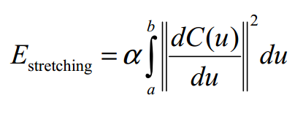
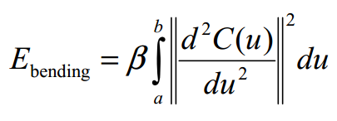
Active contours – Energy minimisation Internal energy

Slide 4
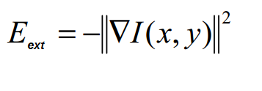
Active contours – Energy minimisation External energy

Slide 5
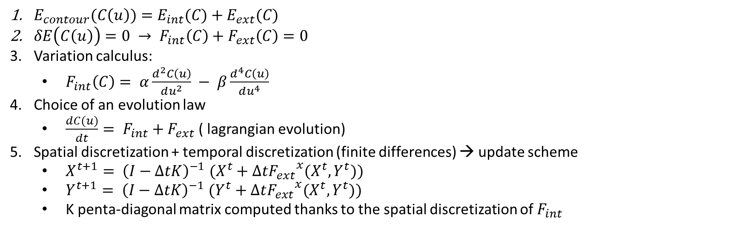
Active contours : Update scheme
$E_{contour}(C\left(u\right))=E_{int}(C)+E_{ext}(C)$
$δE\left(C\left(u\right)\right)=0 → F_{int}\left(C\right)+F_{ext}\left(C\right)=0$
Variation calculus:
$F_{int}\left(C\right)= α\frac{d^{2}C\left(u\right)}{du^{2}} − β\frac{d^{4}C\left(u\right)}{du^{4}}$
Choice of an evolution law
$\frac{dC(u)}{dt}= F_{int}+F_{ext}$ ( lagrangian evolution)
Spatial discretization + temporal discretization (finite differences) → update scheme
$X^{t+1}{= \left(I−ΔtK\right)}^{−1}(X^{t}+Δt{F_{ext}}^{x}(X^{t},Y^{t}))$
$Y^{t+1}{= \left(I−ΔtK\right)}^{−1}(Y^{t}+Δt{F_{ext}}^{x}(X^{t},Y^{t}))$
K penta-diagonal matrix computed thanks to the spatial discretization of $F_{int}$

Slide 6
GVF - Nico

Slide 7
VFC - Nico

Slide 8
VFC2 - Nico

Slide 9
Parametres de VFC - Nico

Slide 10
Initialisation - Nico

Slide 11
Convergence to concavities (1/2)

Slide 12
Convergence to concavities (2/2)

Slide 13
Robustness to noise : GVF with salt&pepper noise

Slide 14
Robustness to noise : VFC with salt&pepper noise

Slide 15
Robustness to noise : GVF with additive gaussian noise

Slide 16
Robustness to noise : VFC with gaussian noise

Slide 17
Robustness to noise : impact of the kernel radius ?

Slide 18
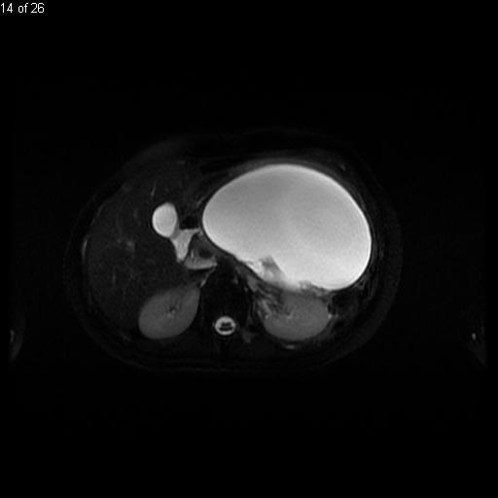
Conclusion and further work

Slide 19
Conclusion and further work

